Slide 1
Transformational Collaborative Outcomes Management
Managing the business of helping
It’s about personal change
John S. Lyons, Ph.D.
Chapin Hall at the University of Chicago

Slide 2
Keys to implementation
Support staff throughout the learning process—creating a learning culture
Understand what it is and what it is not.
Leadership buy-in/support. Need an organizational champion with some clout
Embed in the process of care—specifically treatment planning and supervision at minimum
Create a culture that celebrates success rather than enables complaint
Embrace information culture opportunities—streamline paperwork and increase respect for the accuracy of documentation

Slide 3
Adult Needs and Strengths Assessment (ANSA)
The ANSA is not the point
John S. Lyons, Ph.D.
Chapin Hall at the University of Chicago

Slide 4
Key talking points
The human serving system has been systematically diminishing itself by managing the wrong business. It is not a service, it is a transformational offering.
It is possible to manage transformations but this is radically different than managing services.
It is hard to shift to transformation management, but it is possible if we can all commit to trying to work differently.
Fundamentally, this process is about restoring trust in the system and learning to communicate effectively.

Slide 5
Understanding the Business of Residential Treatment: The Hierarchy of Offerings
I. Commodities
II. Products
III. Services
IV. Experiences
V. Transformations
        - Gilmore & Pine, 1997

Slide 6
Problems with Managing Services
Find people and get them to show up
Assessment exists to justify service receipt
Manage staff productivity (case loads)
Incentives support treating the least challenging individuals.
Supervision as the compliance enforcement
An hour is an hour. A day is a day
System management is about doing the same thing as cheaply as possible.

Slide 7
How Transformation Management is Different
Find people you can help, help them and then find some one else
Accuracy is advocacy. Assessment communicate important information about the people we serve
Impact (workload) more important that productivity
Incentives to treat the most challenging individuals.
Supervision as teaching
Time early in a treatment episodes is more valuable than time later.
System management is about maximizing effectiveness of the overall system

Slide 8
Next Problem. How do you engineer effectiveness?
Because of our service management mentality the lowest paid, least experienced people spend the most time with our youth and families.
Need to take collective wisdom and somehow help young staff get up to speed on being effective really fast.
Pilots don’t fly planes anymore. Planes fly themselves. Is there a lesson there for us?

Slide 9
Third problem. Where’s the love? Have we lost faith in each other caring about our youth and families?
Many different adults in the lives of the people we serve
Each has a different perspective and, therefore, different agendas, goals, and objectives
Honest people, honestly representing different perspectives will disagree
This creates inevitable conflict.
This reality has created a significant amount of distrust

Slide 10

Transformational Collaborative Outcomes Management
Developing a shared vision— a shared understanding of the problems and how they came about, shared goals and a set of actions to achieve those goals– is key to any change happening.
Notes:
Developing a shared vision one of the key outcomes of TCOM . We all know that for the CANS to really work as an assessment strategy, we must have TCOM as the value that fuels our work. Unless you are OCD or, in Rorschach terms – an over incorporator – a completed CANS can be overwhelming. We can separate out the Actionable Items or the 2s and 3s, but then what? How to we get from CANS ratings to Goals and Objectives? For change to happen TCOM doesn’t stop with information gathering.

Slide 11
Restoring Trust—the essential outcome of conflict management
Different perspectives cause inevitable conflict. Resolving those perspectives requires conflict resolution strategies.
There are two key principles to effective conflict resolution
  There must be a shared vision
  There must be a strategy for creating and communicating that shared vision

Slide 12
Core Concepts of Transformation Management
We need to create and communicate a shared vision that is about wellbeing of our children and families. This shared vision has to involve the participation of all key partners in order to restore trust.
We need to use that information to make good decisions about having an impact (rather than spending time and space with youth). This information must be used simultaneously at all levels of the system to ensure that we are all working towards the same goals.
This is not going to be easy.

Slide 13
The Philsophy: Transformational Collaborative Outcomes Management (TCOM)
Transformation means that it is focused on the personal change that is the reason for intervention.
Collaborative means that a shared visioning approach is used--not one person’s perspective.
Outcomes means the measures are relevant to decisions about approach or proposed impact of interventions.
Management means that this information is used in all aspects of managing the system from individual family planning to supervision to program and system operations.

Slide 14
Managing Tension is the Key to Creating an Effective System of Care
Philosophy—always return to the shared vision. In the mental health system the shared vision are people with mental health challenges
Strategy—represent the shared vision and communicate it throughout the system with a standard language/assessment
Tactics—activities that promote the philosophy at all the levels of the system simultaneously

Slide 15
Why I don’t think traditional measurement approaches help us manage transformations
Most measures are developed from a research tradition. Researchers want to know a lot about a little. Agents of change need to know a little about a lot. Lots of questions to measure one thing.
Traditional measurement is arbitrary. You don’t really know what the number means even if you norm your measures.
Traditional measurement confounds interventions, culture and development and become irrelevant or biases. You have to contextualize the understanding of a person in their environment to have meaningful information.
Triangulation occurs post measurement which is likely impossible.

Slide 16
The Strategy: CANS and FAST
Six Key Characteristics of a Communimetric Tool
Items are included because they might impact care planning
Level of items translate immediately into action levels
It is about the individual not about the individual in care
Consider culture and development
It is agnostic as to etiology—it is about the ‘what’ not about the ‘why’
The 30 day window is to remind us to keep assessments relevant and ‘fresh’

Slide 17
TCOM Grid of Tactics
 | Individual | Program | System
Decision Support | Care Planning Effective practices EBP’s | Eligibility Step-down | Resource Management Right-sizing
Outcome Monitoring | Service Transitions & Celebrations | Evaluation | Provider Profiles Performance/ Contracting
Quality Improvement | Case Management Integrated Care Supervision | CQI/QA Accreditation Program Redesign | Transformation Business Model Design

Slide 18
Action Levels
Needs
  0 No evidence, no need for action
  1 Watchful waiting/prevention
  2 Action
  3 Immediate/intensive action
Strengths
  0 Centerpiece strength—focus of plan
  1 Useful strength (but not focus)
  2 Identified strength but need to build
  3 Not yet identified

Slide 19
Promoting Collaborative Treatment Planning
Collaboration is interactive and ongoing
Skill building to get from the what to the why
  Importance of client’s theory of change and clinical expertise
Transparency and use of data with clients and families
  Supervisor training and support
    How does the client/family make sense of these ratings?
    Supervise like the client is in the room
Clinical practices focused on client centered approaches
Revised documentation and timelines

Slide 20
A SIMPLE VERSION OF THE
PROCESS OF CARE
START with the ‘WHAT’ (describe the circumstance)
CONSIDER the ‘WHY’ (understand what is happening. This is a clinical formulation)
DETERMINE the ‘HOW’ (develop a plan to help)

Slide 21

Getting to the How
Clear need to bundle actionable items into treatment targets
Help to focus on high impact needs or the most annoying problem.
Work together to understand the complexity of the needs
Notes:
There is a clear need to bundle items together to identify the actionable items that will create the most leverage – these become your treatment targets.
We also want to use our clinical expertise to help families buy into working on items with most long range impact and/or impact the largest number of needs.
However, it can be really helpful to engagement to address something that is just the most annoying problem to the family.
We think of this as the low hanging fruit that can create a sense of transformation quickly for the family.
For example, think of the most annoying thing your child does – my two kids compete with each other by yelling mommy at ever increasing volumes. If someone could quickly reduce the volume or frequency of that yelling, I’d be willing to do anything else they wanted ☺
We want to work together with families to understand the complexity of the needs – how the needs relate to each other, how they are linked together and which needs impact others.
This becomes a process of interactive case conceptualization and treatment planning.

Slide 22
Treatment Planning Form
Background Needs (ratings of 2 or 3)
  Can’t change
  Choose not to address at this time
Treatment Targets (ratings of 2 or 3)
  Causes
Anticipated Outcomes (ratings of 2 or 3)
  Effects
Useful Strengths (ratings of 0 or 1)
Strengths to build (ratings of 1, 2 or 3)

Slide 23
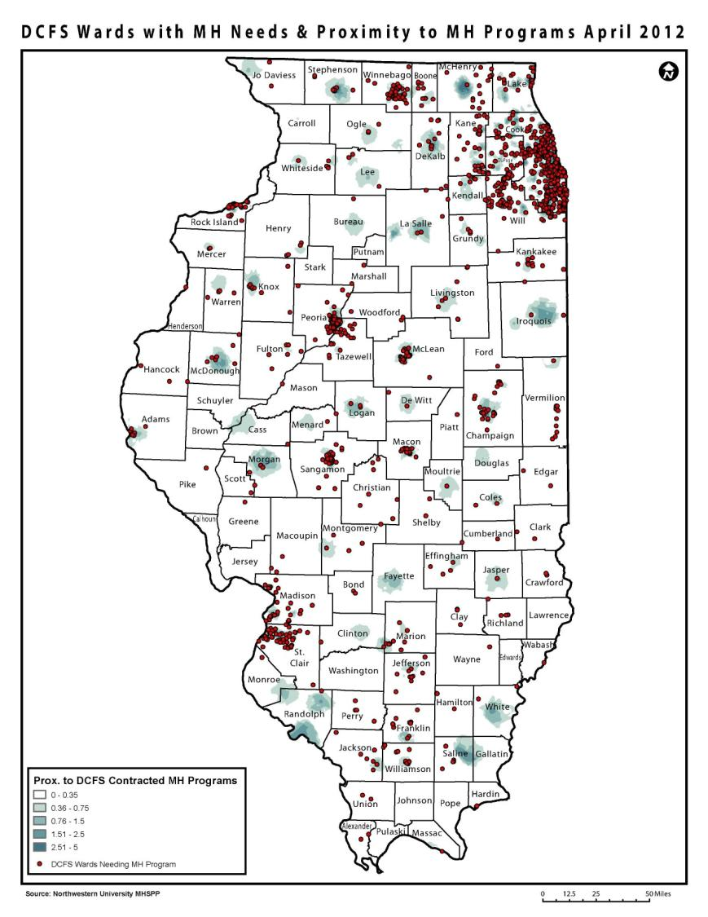
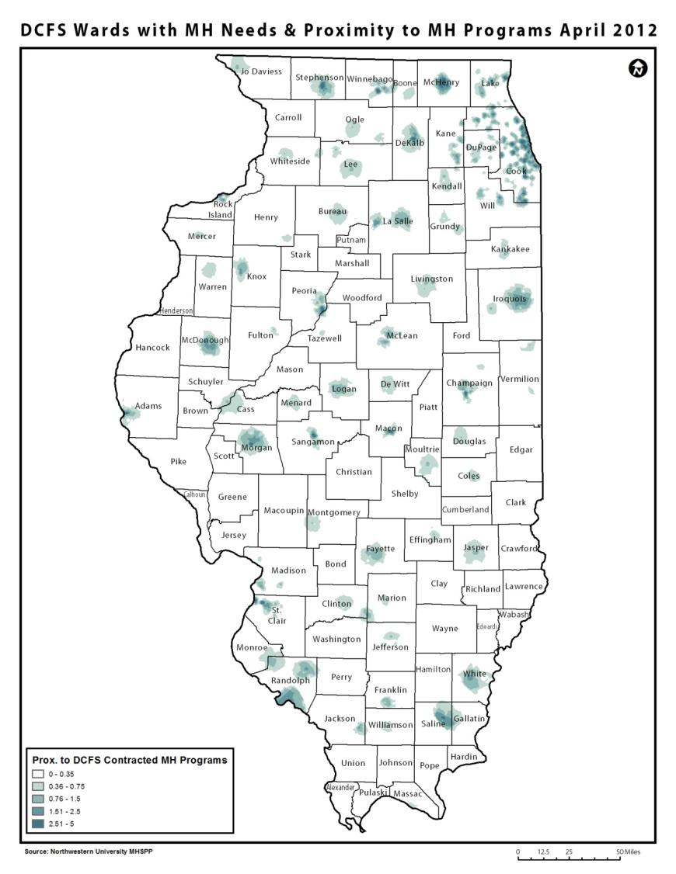
By using Provider and Child proximity scores IDCFS will be able to realign contracted services to better serve children and families:
Eliminates waste by identifying contracted services that may be at locations which are difficult for children reach.
  A proximity threshold
Identifies areas where DCFS needs to recruit new providers, or encourage providers to relocate, in order to improve service proximity for children.
  Convert clusters of children into ‘hot spots’
  Convert clusters of providers into ‘cold spots’
Optimizes current contracts by placing them with providers that children can easily reach.
  Allows you to model impacts prior to action.
Notes:
It also allows you to quickly see if children needing mental health services fall into areas that have close proximity to those services.

Slide 24
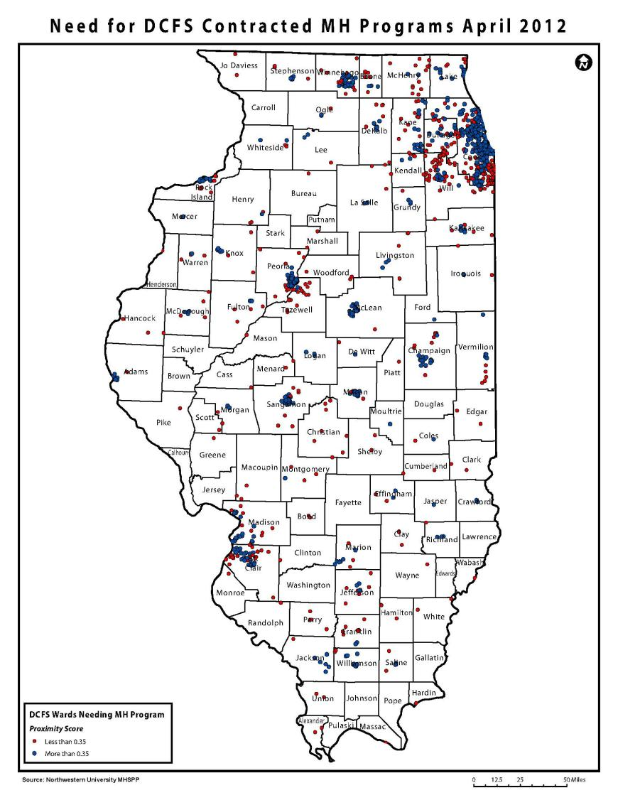
By using Provider and Child proximity scores IDCFS will be able to realign contracted services to better serve children and families:
Eliminates waste by identifying contracted services that may be at locations which are difficult for children reach.
  A proximity threshold
Identifies areas where DCFS needs to recruit new providers, or encourage providers to relocate, in order to improve service proximity for children.
  Convert clusters of children into ‘hot spots’
  Convert clusters of providers into ‘cold spots’
Optimizes current contracts by placing them with providers that children can easily reach.
  Allows you to model impacts prior to action.
Notes:
The proximity threshold for Illinois, i.e. the point at which a child has close enough proximity to providers to see a positive outcome in their well being, is 0.35. Color coding all children who need mental health services by who falls above or below that cut off makes clear where there are clusters of children in need of additional services. It also allows for an easy reporting metric – i.e. the % of child above or below the proximity threshold for mental health providers.

Slide 25
Strategies for Engagement and Shared Visioning
A conversation
About the what, not about the why—no shame or blame
Time spent in understanding pays off in impact
Output of an assessment process
It is not an event
Once one CANS/ANSA is completed you don’t ‘redo’ it, you check in on it.

Slide 26
Strategies Used For Treatment Planning
Matching (with prioritization)
Transformational Care Planning (CIMH)
Clustering (Northwestern)
Cross Cutting Needs (San Francisco)
Treatment and Recovery Planning (TARP)

Slide 27
Responsibilities in Supervision
Ensure compliance with policies and procedures
Help manage schedules and workloads
Improve quality of care provided by supervisees
Facilitate professional development
Problem solve challenges as they arise

Slide 28
Opportunities in Supervision
Developing marketable skill sets including basic management skills
Broadening clinical expertise through vicarious treatment experiences
Mentoring bright young workers
Helping improve the lives of a larger group of children and families

Slide 29
Strategies Used by Supervisors
Review and sign off on any CANS/ANSA before submitted
Discuss any case by first reviewing the CANS/ANSA so that it serves as Cliff/Coles Notes on the case
Shadow a supervisee doing a CANS/ANSA with a family or individual
Have a supervisee shadow supervisor doing a CANS/ANSA with a family or individual
Use CANS/ANSA at the start of any discussion in case presentations or team supervisions
Review family service plans using the SPANS or another approach to ensure that planning is guided by how the family or individual is understood using CANS/ANSA
Monitor supervisee level reports on the status of their cases and outcomes from episodes of care and review performance with supervisees

Slide 30
Strategies for Decision Support
Define Choices/Options
  Treatment or placement type
  Intensity of care
  Level of Care
Define Child/Family Level inputs into good decision making
Create version of the tool that reflects that information
Model and test algorithm

Slide 31
Percent of hospital admissions that were low risk by racial group
Adapted from Rawal, et al, 2003

Slide 32
Key Decision Support CSPI Indicators
Sorted by Order of Importance in Predicting Psychiatric Hospital Admission
If CSPI Item | Rated as | Start with 0 and
Suicide | 2,3 | Add 1
Judgment | 2,3 | Add 1
Danger to Others | 2,3 | Add 1
Depression | 2,3 | Add 1
Impulse/Hyperactivity | 2,3 | Add 1
Anger Control | 3 | Add 1
Psychosis | 1,2,3 | Add 1
Ratings of ‘2’ and ‘3’ are ‘actionable’ ratings, as compared to ratings
of ‘0’ (no evidence) and ‘1’ (watchful waiting).

Slide 33
Change in Total CSPI Score by Intervention and Hospitalization Risk Level (FY06)

Slide 34
Strategies to Define Outcomes
Item Level
  Actionable vs Not Actionable and
  Useful vs Not Useful
Dimension Scores
  Average items and multiply by 10
Total Score
  Combine dimension scores for functioning, symptoms and risks
Reliable Change Indices

Slide 37
Illinois Trajectories of Recovery before and after entering different types of Child Welfare Placements

Slide 38
Shifting to Transformational Management is not easy
To be successful we must learn to:
  embed shared vision approaches into the treatment planning and supervision at the individual level
  treat documentation with the same level of respect that we treat our youth and families
  aggreggate and use this information to inform policy decisions
  change financing structures to support transformation management, not service receipt.
  trust each other

Slide 39
The Myths
1. We are running a service delivery system
2. Outcomes management is a form of program evaluation
3. Program evaluation is a form of applied research
4. Objective is better than subjective
5. You have to triangulate your outcomes by measuring different perspectives
6. Status at discharge represents an outcome
7. Changes in means represents meaningful changes in people

Slide 40
Myth 2: Outcome Management is not program evaluation and
Myth 3: Program evaluation is not research. Therefore, Outcomes Management is not research
It is engineering……

Slide 41
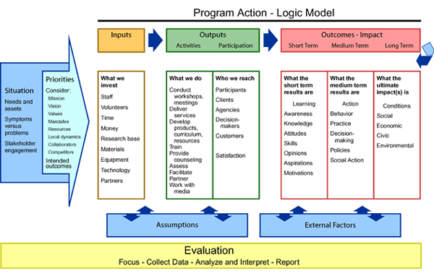

Slide 42
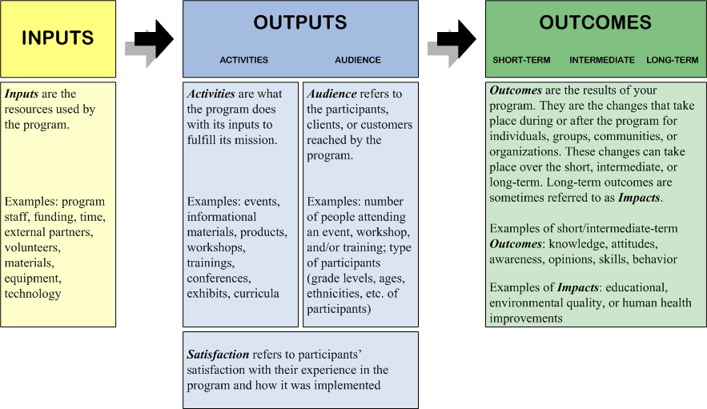

Slide 43
Engineering
The creative application of scientific principles to design or develop structures, machines, apparatus, or manufacturing processes, or works utilizing them singly or in combination; or to construct or operate the same with full cognizance of their design; or to forecast their behavior under specific operating conditions; all as respects an intended function, economics of operation or safety to life and property (American Engineer’s Council, 1947).

Slide 44
Myth 4: Objective is better than subjective
This belief leads us to focus on measuring things that are ‘objective’ rather than things that are relevant to a transformational enterprise
There is substantial body research that demonstrates that global, subjective ratings are often more reliable and valid that very specific ratings
Subjective does not means unreliable. It means that judgment is involved. How can you be clinically, culturally or developmentally sensitive without exercising judgment

Slide 45
Myth 5: You must triangulate by measuring multiple perspectives
Youth self report, Parent report, therapist report, teacher report and so forth represent the standard of triangulation in research and program evaluation.
We have been trying for more than 50 years to statistically create a consensus outcome-it is impossible.
You have to triangulate first and then measure.

Slide 46
Scenario 1: Youth is distressed and the parent is minimizing the situation. With treatment the youth feels better and the parents come to realize the youth’s mental heath needs

Slide 47
Scenario 2. Parent is catastrophizing and youth is minimizing. With treatment the youth understand his her mental health needs better and the parent sees progress

Slide 48
The problem with means of single perspectives—the average of two clinically successful treatment episodes equates to no effect

Slide 49
Myth 6 Status at discharge represents an outcome
There is a large body of research that demonstrates that the people who need our interventions the least have the best outcomes.
All of that research uses status at discharge as the definition of an outcome.
Of course, many of these individuals who ‘need it the least, have already achieved the positive status prior to the intervention.
This body of research is simply irrelevant for the business of personal change

Slide 50
Myth 7. Means reflect meaningful change
Let’s say you effectively help 75% of the youth you serve.
But the other 25% escalate and require something more intensive.
How does the mean change reflect your success rate?

Slide 51
Mean Outcomes of a Program that is successful 75% of the time

Slide 52
Barriers to Collaboration
Pathology/deficit based model required by funders
Not enough time. Focus on “getting the numbers up”
Cautious about disallowances; documentation must highlight deficits
“Not how I was taught in school”
Focus on clinical expertise and theoretical orientation
Pressure to focus on the referring party
Misunderstanding of recovery and wraparound

Slide 53
Keys to implementation
Support staff throughout the learning process—creating a learning culture
Understand what it is and what it is not.
Leadership buy-in/support. Need an organizational champion with some clout
Embed in the process of care—specifically treatment planning and supervision at minimum
Create a culture that celebrates success rather than enables complaint
Embrace information culture opportunities—streamline paperwork and increase respect for the accuracy of documentation

Slide 54
Distinguish between a ‘centerpiece’ piece and a ‘useful’ strength
Useful
  Play youth hockey
  Sing in a choir
  Supportive family members
  Interested in what happens around them
Centerpiece
  Good enough at hockey to get drafted or scholarship
  Soloist in choir, could get scholarship
  Parents fully committed to doing everything in their power to support the success of their children
  Constantly seeks new stimuli, exposure, opportunities to learn

Slide 55
CANS as Conversation vs Checklist
Don’t treat it like an assessment
Don’t go through it in the order of the form
Encourage the family to tell their story in their words and then work with them to translate it into a common language
Listen as family member talk and remember key things that say that would translate into CANS needs or strengths

Slide 56
CANS as unstructured conversation
Scripted interview protocols are generally more useful to clinicians than to families. Some families like them others find them off putting.
The CANS is not an assessment it is a structured way of communicating the output of an assessment process

Slide 57
Suspected or unsubstantiated sexual abuse?
Please rate as ‘1’ on Sexual Abuse

Slide 58
Cultural Trauma? It depends
Could be a ‘2’ or ‘3’ on Cultural Stress
Could be a ‘2’ or ‘3’ on Cultural Differences
Could also be a ‘2’ or ‘3’ on Identity
Could be a ‘2’ or ‘3’ on Adjustment to Trauma

Slide 59
Actionable need versus something a family wants to work on?
If a family believes something is a need they want to work on and the clinician doesn’t then you have an engagement and/or education problem or a misunderstanding of how to use the action levels
Consensus based assessment doesn’t simply mean asking a family what they want to work on.

Slide 60
How to deal with stigma of MH
Model a non-judgmental cultural world view—MH professionals are now one of the greatest causes of stigma
Couch the discussion on the impact of the parent MH needs on their caregiving role not just as a characteristic of them. It is not a diagnosis, it is a need

Slide 61
Selective mutism
About the what not about the why—it will always be at least a ‘2’ on Communication
It may also be rated
  A ‘2’ or ‘3’ on Anxiety
  A ‘2’ or ‘3’ on Sanction Seeking Behavior
  A ‘2’ or ‘3’ on Oppositional Behavior

Slide 62
Who are the caregivers when a child is in foster care
It depends
Ask yourself----what needs to be address for this child to achieve stable wellbeing and healthy development?

Slide 63
Multiple caregivers?
Rate them as it affects caregiving

Slide 64
In Recovery from Substance Use
Rate as ‘1’ on Caregiver Substance use
The concept is whether or not it is relevant in the last 30 days, not did it happen in the last 30 days.

Slide 65
Pica—why in Risk Factors
This version comes form Children First so you know better than me.
The CANS perspective---put it where ever it makes the most sense.

Slide 66
Is a foster care placement an intervention that is in place
It certainly is for the Caregivers.
Not so much for children—it is where they are being parented.

Slide 67
Should there be a more balanced focus on Needs and Strengths?
That’s up to you.
I would say that would not be a bad idea.

Slide 68
Bringing history forward
Does it matter in the last 30 days…..

